Slide 1
ITCS 3143
YIN HANG KWOK
800831787
E05 - Point Transformation

Slide 2
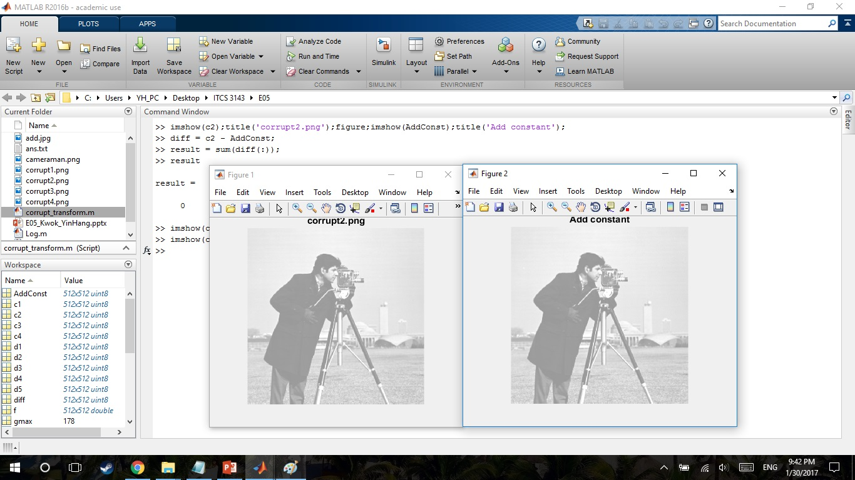
Add constant. Note constant can be negative.
AddConst = I + 100;
d1 = c2 - AddConst;
s1 = sum(d1(:));

Slide 3
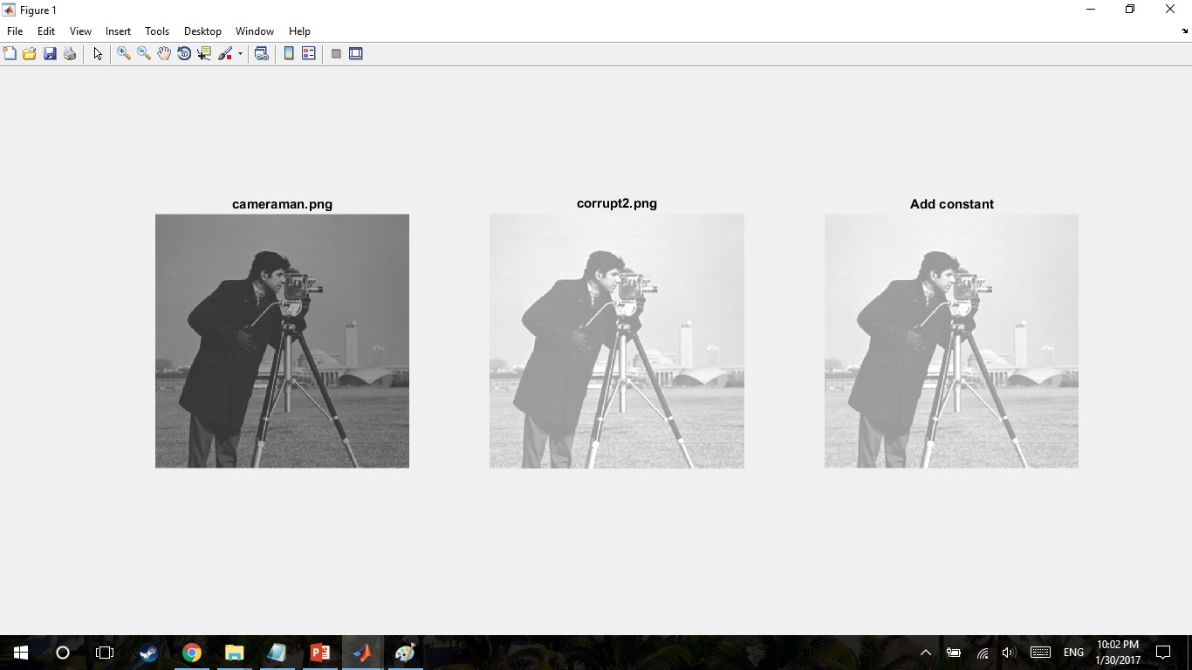
Add constant.

Slide 4
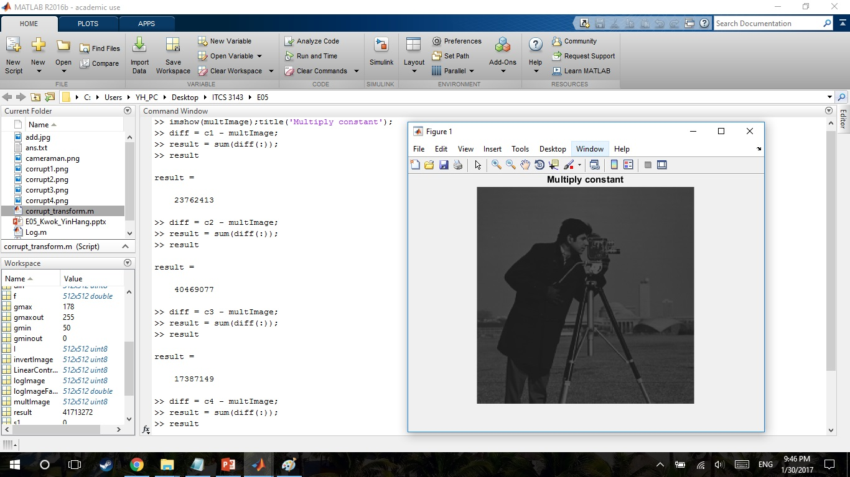
Multiply constant. Note constant can be < 1.0
multImage = I * 0.5;
d4 = c2 - multImage;
s4 = sum(d4(:));

Slide 5
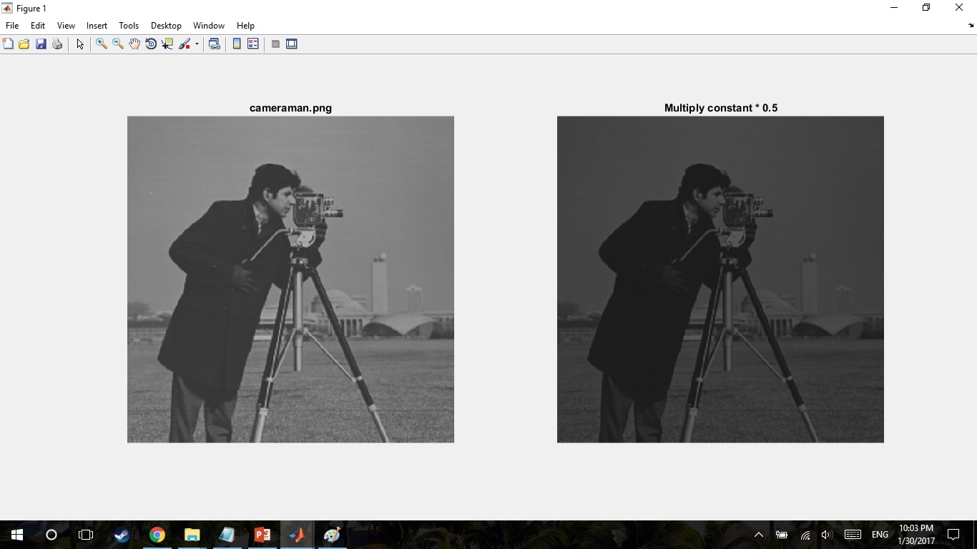
Multiply constant.

Slide 6
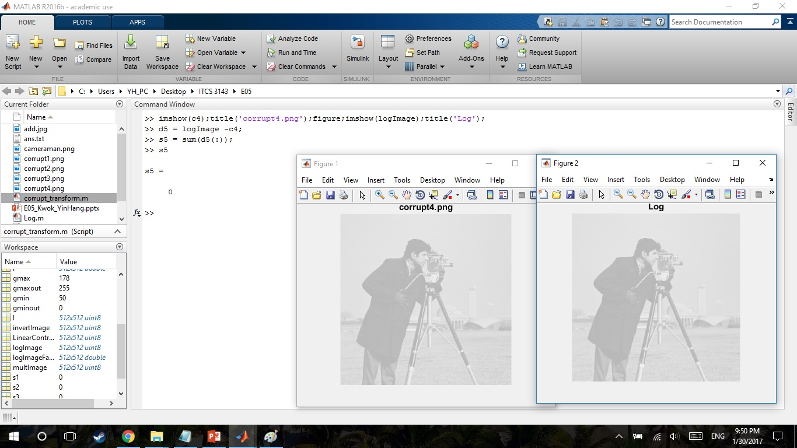
Log
f = double(I);
logImageFactor = log(f+1);
logImage = 255/(log(256));
logImage = uint8(logImage*logImageFactor);
d5 = logImage - c4;
s5 = sum(d5(:));

Slide 7
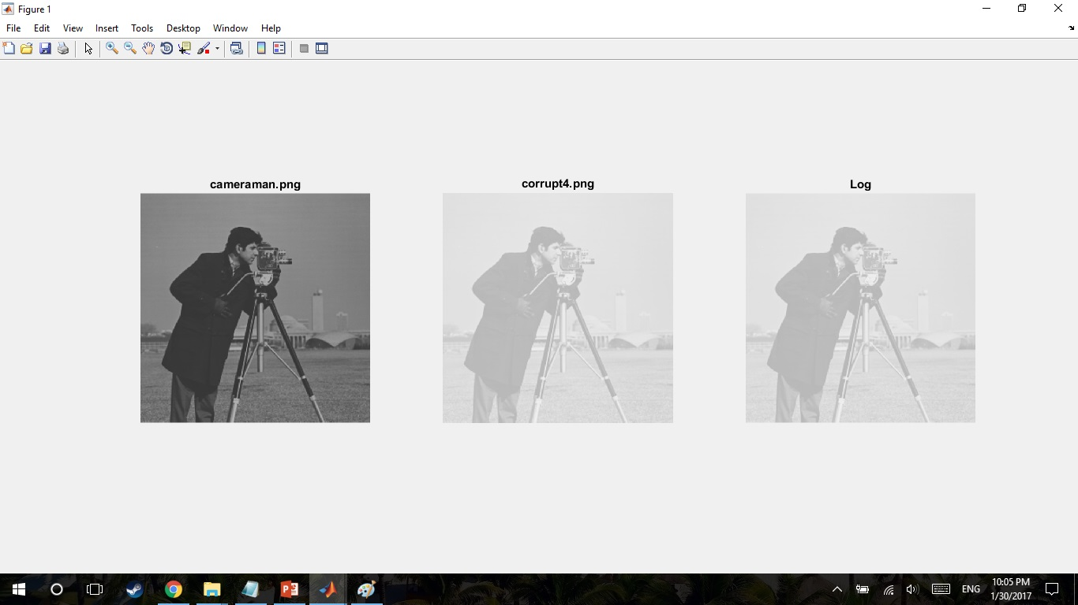
Log

Slide 8
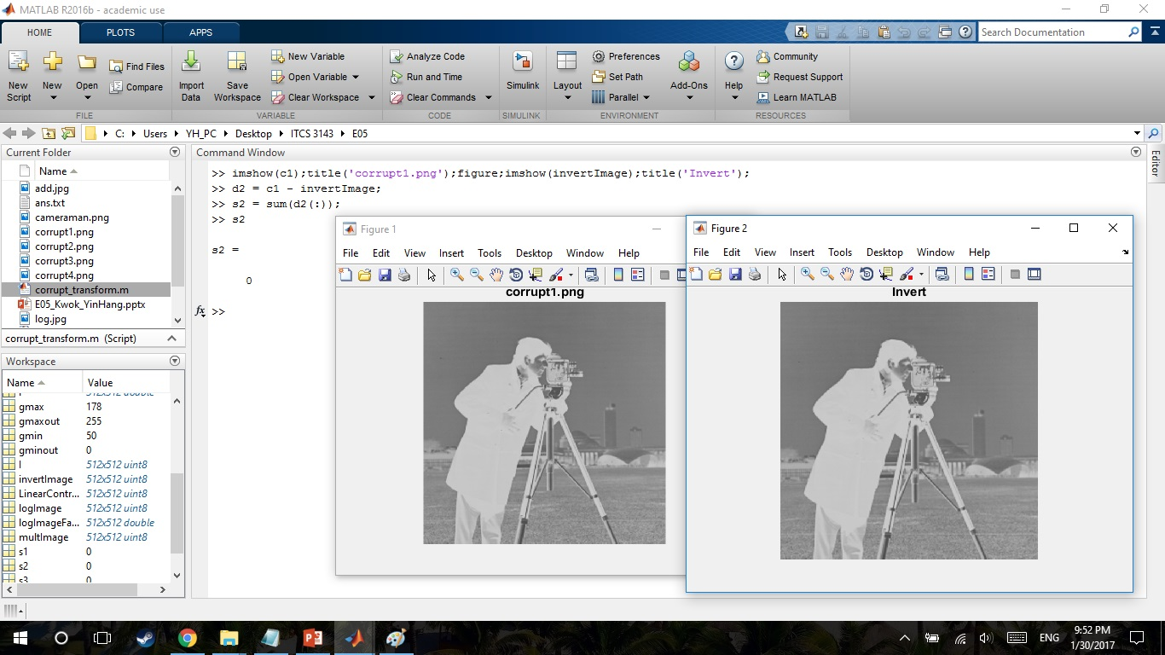
Invert
invertImage = 255-I;
d2 = c1 - invertImage;
s2 = sum(d2(:));

Slide 9
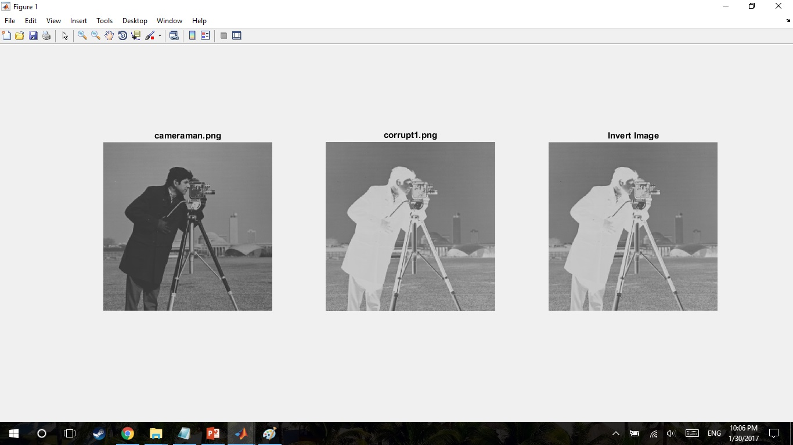
Invert

Slide 10
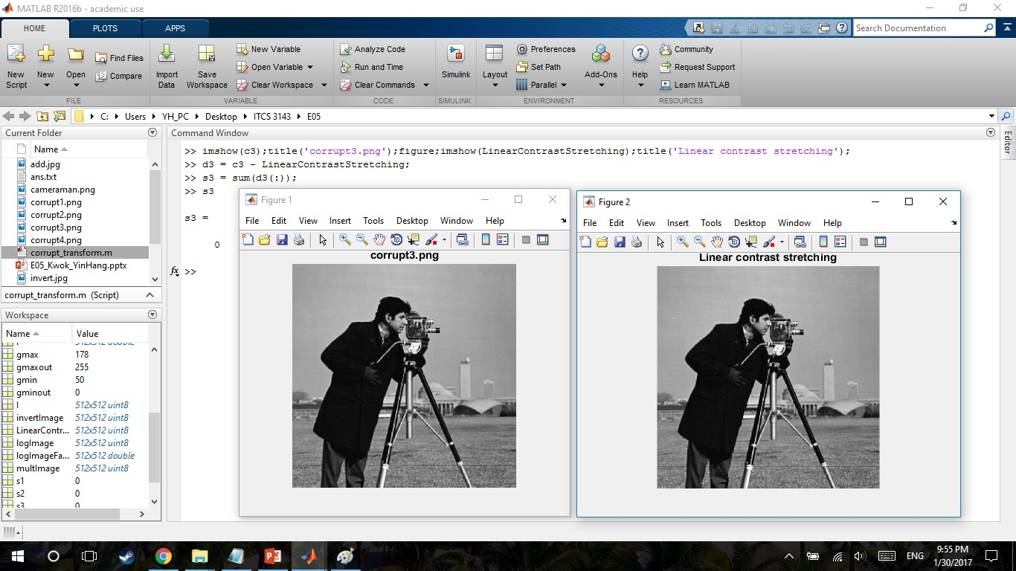
Linear contrast stretching
gmin = min(I(:));
gmax = max(I(:));
gmin = double(gmin);
gmax = double(gmax);
gminout = 0;
gmaxout = 255;
LinearContrastStretching = ((gmaxout - gminout)/(gmax - gmin))*(I - gmin) + gminout;
d3 = c3 - LinearContrastStretching;
s3 = sum(d3(:));

Slide 11
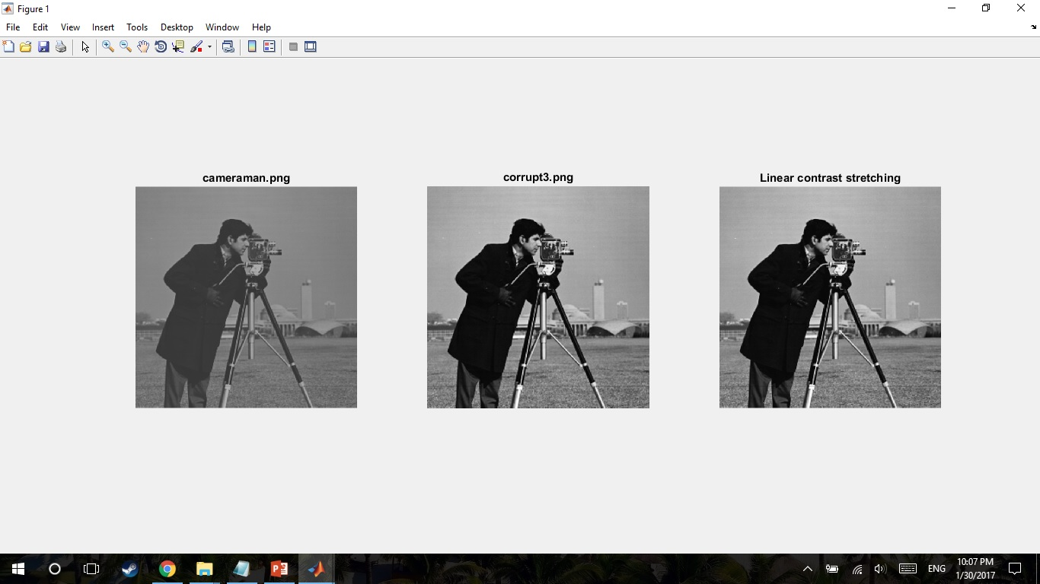
Linear contrast stretching

Slide 12
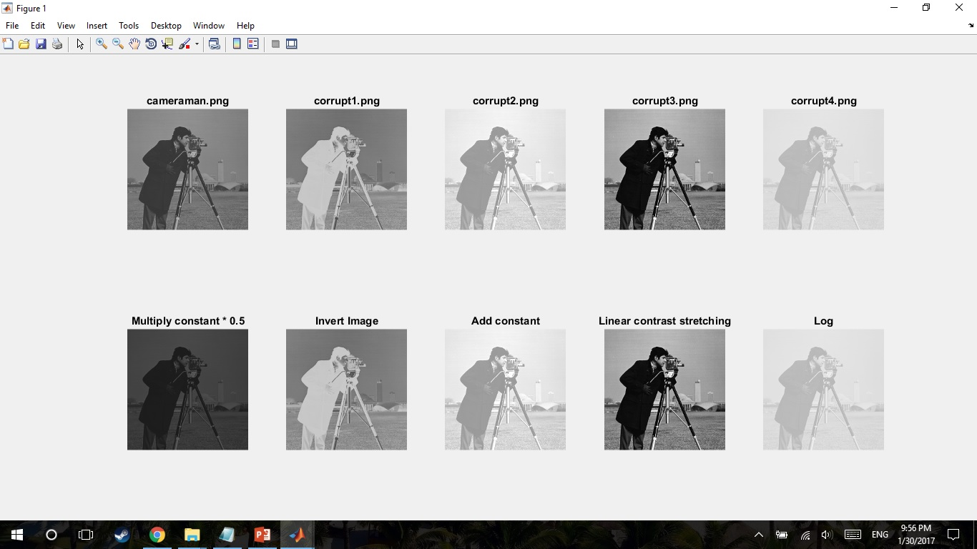
Result

